Slide 1
Organizational Culture
Bob Marshall, MD MPH MISM FAAFP
DoD/MAMC Clinical Informatics Fellowship

Slide 2
Learning Objectives
Define organizational culture
Provide background on organizational culture
Review the types of organizational culture
Provide principles of organizational culture and how to mobilize (change) culture
Discuss what makes for a great organizational culture

Slide 3
Definition 1
The values and behaviors that contribute to the unique social and psychological environment of an organization
Organizational culture includes an organization's expectations, experiences, philosophy, and values that hold it together, and is expressed in its self-image, inner workings, interactions with the outside world, and future expectations
It is based on shared attitudes, beliefs, customs, and written and unwritten rules that have been developed over time and are considered valid

Slide 4
Definition 2
Also called corporate culture, it's shown in
the ways the organization conducts its business, treats its employees, customers, and the wider community,
the extent to which freedom is allowed in decision making, developing new ideas, and personal expression,
how power and information flow through its hierarchy, and
how committed employees are towards collective objectives

Slide 5
How OC Affects Organizations
It affects the organization's productivity and performance, and provides guidelines on customer care and service, product quality and safety, attendance and punctuality, and concern for the environment
It also extends to production-methods, marketing and advertising practices, and to new product creation
Organizational culture is unique for every organization and one of the hardest things to change

Slide 6
Why is OC Hard?
While there is universal agreement that (1) it exists, and (2) that it plays a crucial role in shaping behavior in organizations,
There is little consensus on what organizational culture actually is, never mind how it influences behavior and whether it is something leaders can change
Without a reasonable definition (or definitions) of culture, we cannot hope to understand its connections to other key elements of the organization, such as structure and incentive systems
Nor can we develop good approaches to analyzing, preserving and transforming cultures

Slide 7
Is Organization Culture Still Relevant?
The culture of a workplace makes the organization what it is
Organizational culture is no different from ethnic culture except it usually includes people from all different backgrounds and histories
These cross-cultural connections can blossom into ingenuity and understanding that promote a better workplace and arguably a better world community
OC defines standards and set procedures that give the organization, and furthermore the employees, direction as they conduct their daily business
Culture unifies people and allows them to learn from one another and strive to be the best they can be
No organization exists without a culture, but every organization operates under a different type of one

Slide 8
Strong versus Weak Organizational Culture
There are two overarching models that organizations will fall into, strong culture and weak culture
In a strong culture, employees have a sense of empowerment and understanding of the organizational goals, regulations and philosophy
This kind of culture allows employees to be internally driven and feel respected which benefits the overall health of the organization
In a weak organizational culture, employees are lost, unmotivated and operate under a regime of fear
Fear may motivate individuals but not for long and for all of the wrong reasons
Employees should never feel like they will be wrongly reprimanded for making mistakes or needing a little extra guidance

Slide 9
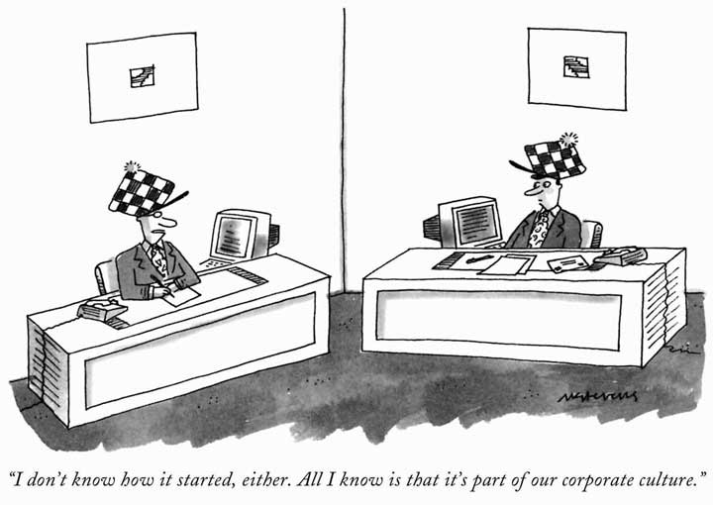
Types of Organizational Culture

Slide 10
Nine Types of Organizational Culture
Academy Culture
Normative Culture
Pragmatic Culture
Club Culture
Baseball Team Culture
Fortress Culture
Tough Guy Culture
Process Culture
Bet Your Company Culture

Slide 11
Academy Culture
Academy culture depends on employees who are highly skilled, studious and welcome further training and advancement
This type of work place environment thrives off of intense training for employees being brought on board and ongoing training for the employees already there
Organizations that choose to follow this culture are very particular about who they hire, their existing skill sets and their willingness to learn and grow
This format of management keeps turn-over rates low and the employees eager to do their job to the best of their ability

Slide 12
Normative Culture
This is your everyday corporate workplace
Normative culture is very cut and dry, following strict regulations and guidelines that uphold the policies of the organization
Employees rarely deviate from their specific job role, break rules or do anything other than what is asked of them
These type of organizations run a tight ship and are not suited for every type of employee

Slide 13
Pragmatic Culture
You know that saying the customer is always right?
Well, that is the first and only rule of a pragmatic culture workplace
The customer or client comes before anything or anyone else
Because every customer is different, these type of work places are very opposite of the normative culture environment as employees don’t adhere to strict rules
Whatever the customer wants, the customer gets (within reason, of course)

Slide 14
Club Culture
Nothing but the best
This type of culture requires employees to be very skilled and competent in their niche of work
Educational qualifications, prior work experience and even personal interests are taken into consideration before an employee is hired
Club culture can be seen in organizations like the FBI, commercial pilots and specialty branches of the military

Slide 15
Club Culture cont
The hiring process can be pretty intense for these work environments, requiring multiple interviews, a stellar resume (and references to back it up), background checks and so on
The upside of being a part of a club culture is your hard work will pay off
These types of employers often reward hard work with promotions but with that are frequent appraisals of your work and role within the company

Slide 16
Baseball Team Culture
This could be the best type of organizational culture from an employee’s stand point
Baseball team environments say it’s all about the employees
As long as the workers are happy, comfortable and feel respected, the work will get done and the employees will want to stick with the company for the long haul
Google is a good example of a baseball team culture
Company outings are a regular thing, social events within the office and incentives are a big component of this type of culture

Slide 17
Fortress Culture
This type environment is all about the numbers
If the organization is doing well as a result of the employee’s productivity then the employees continue to have a job
If the organization begins to see a downfall in success, then the individuals that aren’t pulling their weight are terminated
With such a high termination rate these companies will hire a new set of people and be forced to train them only to find out they cannot stay up to speed
However, if you are good at what you do you will often be praised and will not have to worry about job security

Slide 18
Tough Guy Culture
Tough guy culture is basically another way of saying micro-management
Employees are monitored every step of the way, and when something does not meet the standards or expectations of the organization, the employee is given guidance and monitored further
It can be a tough (hence the name) environment for some to work in, especially if you are independent and have a creative mind
Sometimes these cultures follow the three-strikes-you’re-out practice in which you can be terminated if you do not act on any corrections provided to you during your review
These type of organizations want to ensure consistency and commitment to their customers, and they need employees that can be shaped to do just that

Slide 19
Process Culture
This type of culture provides a set of regulations and procedures that the employees follow
Unlike the normative culture, the regulations are not a bullet-pointed list of do’s and don’ts so much as it is an ideology that the employees adhere to
Employees know what they are getting into when they sign-up and are often self-starters
Unlike tough guy culture, these employees are not micro-managed and they rarely are given performance reviews
If reviews are done, it’s annually and focused on assessing their work on a large scale, their aspirations within the company and potentially a discussion about salary

Slide 20
Bet Your Company Culture
This culture is for the patient risk-takers
Organizations that follow this culture are known to literally bet the success or failure of the organization on single decisions of which the outcome is completely unknown
It can be a wild ride working for this type of organization, as you don’t know what each day is going to bring
The consequences of the decisions made by the individuals working in the bet-your-company culture can be so dire that the organization goes under; contrarily, they can be so excellent that the organization thrives more than ever before

Slide 21
Five Questions about OC
Is your talent strategy rooted in your business strategy?
Does your organization work as distinctively as it competes?
Can you capture what it means to be a member of your organization?
Is your culture built for learning as well as performance?
Can your culture maintain its zest for change and renewal, even when the organization stumbles?

Slide 22
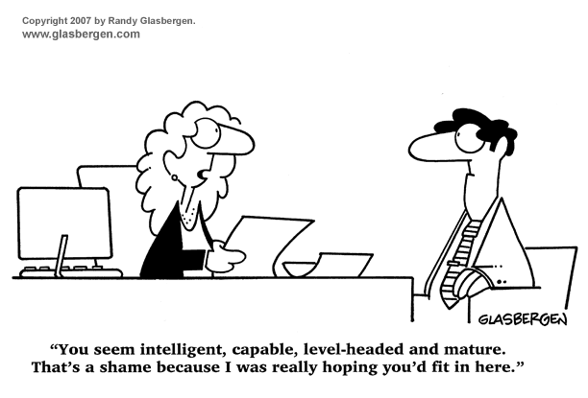
Ten Principles of Organizational Culture
Mobilizing Organizational Culture

Slide 23
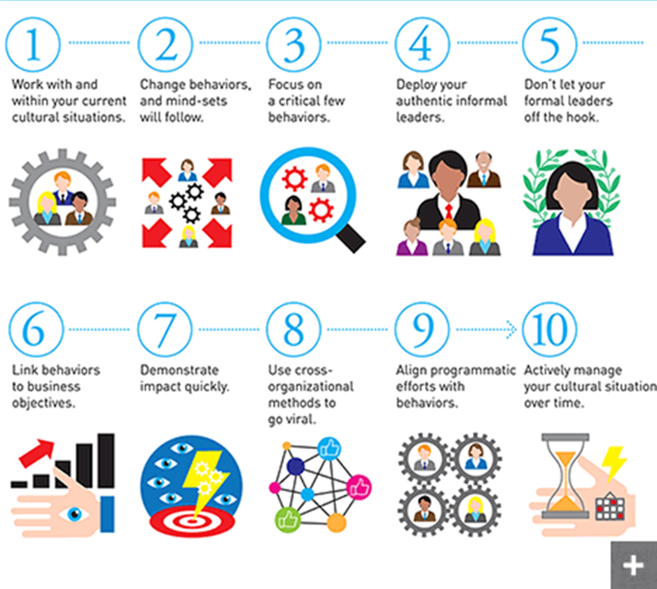

Slide 24
Work with and within your current cultural situations
Deeply embedded cultures cannot be replaced with simple upgrades, or even with major overhaul efforts
Cultures are never all bad, or all good
To work with your culture effectively, you must understand it, recognize which traits are preeminent and consistent, and discern under what types of conditions these traits are likely to be a help or a hindrance
Put another way, there’s both a yin and a yang to cultural traits

Slide 25
Change behaviors, and mind-sets will follow
It is a commonly held view that behavioral change follows mental shifts
This is why organizations often try to change mind-sets (and ultimately behavior) by communicating values and putting them in glossy brochures
Culture is much more a matter of doing than of saying
Trying to change a culture purely through top-down messaging, training and development programs, and identifiable cues seldom changes people’s beliefs or behaviors

Slide 26
Change behaviors cont
Neuroscience research suggests that people act their way into believing rather than thinking their way into acting
Changes to key behaviors — changes that are tangible, actionable, repeatable, observable, and measurable — are thus a good place to start
Some good examples of behavior change relate to empowerment (reducing the number of approvals needed for decisions), collaboration (setting up easy ways to convene joint projects), and interpersonal relations (devising mutually respectful practices for raising contentious issues or grievances)

Slide 27
Focus on a critical few behaviors
Organizations must be rigorously selective when it comes to picking behaviors
The key is to focus on what we call “the critical few,” a small number of important behaviors that would have great impact if put into practice by a significant number of people
Discern a few things people do throughout the organization that positively affect business performance — for example, ways of starting meetings or talking with customers
Make sure those are aligned with the organization’s overall strategy

Slide 28
Focus on a critical few behaviors cont
Also check that people feel good about doing these things, so that you tap into emotional commitment
Then codify them: Translate those critical behaviors into simple, practical steps that people can take every day
Next, select groups of employees who are primed for these few behaviors, those who will respond strongly to the new behaviors and who are likely to implement and spread them

Slide 29
Deploy your authentic informal leaders
Because authentic informal leaders, who are found in every organization, are often not recognized as such, they are frequently overlooked and underused when it comes to driving culture
It is possible to identify such leaders through interviews, surveys, and tools such as organizational network analysis, which allow companies to construct maps of complex internal social relations by analyzing email statistics and meeting records
Once identified, these leaders can become powerful allies who can influence behavior through “showing by doing”

Slide 30
Four Types of Authentic Informal Leaders
Pride Builders – master motivators of other people and catalysts for improvement around them
Exemplars – role models, bringing vital behaviors or skills to life
Networkers – hubs or personal communication within the organization – they know many people and communicate freely and openly with them
Early Adopters – enthusiastically latch onto and experiment with new technologies, processes and ways of working

Slide 31
Don’t let your formal leaders off the hook
Most organizations tend to shunt culture into the silo of human resources professionals
But leaders in all parts of the organization are critical in safeguarding and championing desired behaviors, energizing personal feelings, and reinforcing cultural alignment
The signaling of emotional commitment sets the tone for others to follow
If staff members see a disconnect between the culture an organization promulgates and the one its formal leadership follows, they’ll disengage quickly from the advertised culture and simply mimic their seniors’ behavior
The people at the top have to demonstrate the change they want to see

Slide 32
Link behaviors to business objectives
When people talk about feelings, motivations, and values — all of which are vital elements of strong cultures — the conversation can often veer into abstractions
Too many employees walk away from culture-focused town halls or values discussions wondering how the advice on how to be a better person actually translates into the work they do
To avoid this disconnect, offer tangible, well-defined examples of how cultural interventions lead to improved performance and important outcomes
Select behaviors that are aimed specifically at improving business performance or important outcomes and can be measured over time

Slide 33
Demonstrate impact quickly
We live in an age of notoriously short attention spans
That applies as much to organizational culture as it does to people’s media consumption habits
When people hear about new high-profile initiatives and efforts, and then don’t see any activity related to them for several months, they’ll disengage and grow cynical
That’s why it is extremely important to showcase the impact of cultural efforts on business results as quickly as possible
One effective method of doing so is to stage performance pilots — that is, high-profile demonstration projects

Slide 34
Use cross-organizational methods to go viral
Ideas can spread virally across organizational departments and functions, as well as from the top down and from the bottom up
One powerful way to spread ideas is through social media: blogs, Facebook or LinkedIn posts, and tweets — not from senior management, but from some of the authentic informal leaders mentioned in Principle 4
People are often more receptive to changes in “the way we do things around here” when those changes are recommended or shared by friends, colleagues, and other associates
This kind of credible social proof is more compelling than similar testimonials from someone whose job it is to sell something

Slide 35
Align programmatic efforts with behaviors
It’s also important to match the new cultural direction with existing ways of doing business
Informal mechanisms and cultural interventions must complement and integrate with the more common formal organization components, not work at cross-purposes
By providing the structure in which people work — through disciplines such as organization design, analytics, human resources, and lean process improvement — the formal organization provides a rational motivation for employee actions, while the informal organization enables the emotional commitment that characterizes peak performance

Slide 36
Actively manage your cultural situation over time
Organizations that have had great success working with culture — called “culture superstars” — actively monitor, manage, care for, and update their cultural forces. Why?
As noted at the outset, when aligned with strategic and operating priorities, culture can provide hidden sources of energy and motivation that can accelerate changes faster than formal processes and programs
Even if you have a highly effective culture today, it may not be good enough for tomorrow

Slide 37
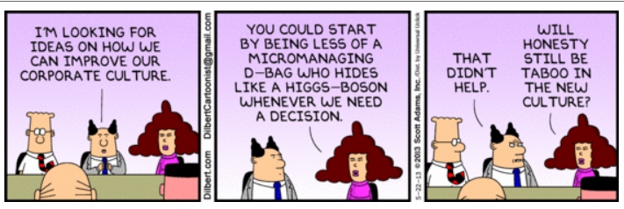
What Makes for a Great Organizational Culture?

Slide 38
Vision
A great culture starts with a vision or mission statement
These simple turns of phrase guide a organization’s values and provide it with purpose
That purpose, in turn, orients every decision employees make
When they are deeply authentic and prominently displayed, good vision statements can even help orient customers, suppliers, and other stakeholders
Nonprofits often excel at having compelling, simple vision statements. The Alzheimer’s Association, for example, is dedicated to “a world without Alzheimer’s”
A vision statement is a simple but foundational element of culture

Slide 39
Values
An organization’s values are the core of its culture
While a vision articulates an organization's purpose, values offer a set of guidelines on the behaviors and mindsets needed to achieve that vision
And while many organizations find their values revolve around a few simple topics (employees, clients, professionalism, etc.), the originality of those values is less important than their authenticity
Google’s values might be best articulated by their famous phrase, “Don’t be evil.” But they are also enshrined in their “ten things we know to be true.”

Slide 40
Practices
Of course, values are of little importance unless they are enshrined in an organization’s practices
If an organization professes, “people are our greatest asset,” it should also be ready to invest in people in visible ways
Similarly, if an organization values “flat” hierarchy, it must encourage more junior team members to dissent in discussions without fear or negative repercussions
And whatever an organization’s values, they must be reinforced in review criteria and promotion policies, and baked into the operating principles of daily life in the firm

Slide 41
People
No organization can build a coherent culture without people who either share its core values or possess the willingness and ability to embrace those values
That’s why the greatest firms in the world also have some of the most stringent recruiting policies
The best firms are “fanatical about recruiting new employees who are not just the most talented but also the best suited to a particular corporate culture”
People stick with cultures they like, and bringing on the right “culture carriers” reinforces the culture an organization already has

Slide 42
Narrative
Any organization has a unique history — a unique story
And the ability to unearth that history and craft it into a narrative is a core element of culture creation
The elements of that narrative can be formal — like Coca-Cola, which dedicated an enormous resource to celebrating its heritage and even has a World of Coke museum in Atlanta — or informal, like those stories about how Steve Jobs’ early fascination with calligraphy shaped the aesthetically oriented culture at Apple
But they are more powerful when identified, shaped, and retold as a part of a firm’s ongoing culture

Slide 43
Place
Place shapes culture
Open architecture is more conducive to certain office behaviors, like collaboration
Certain cities and countries have local cultures that may reinforce or contradict the culture a firm is trying to create
Place — whether geography, architecture, or aesthetic design — impacts the values and behaviors of people in a workplace

Slide 44
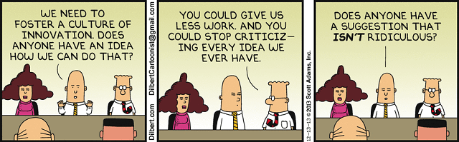
Questions

Slide 45
Back-up Slides

Slide 46
Changing Organizational Culture

Slide 47
Background
A culture is a complex system with a multitude of interrelated processes and mechanisms that keep it humming along
Performance reviews and training programs define the firm’s expectations
Financial reward systems reinforce them
Memos and communications highlight what’s important
And senior leadership actions — promotions for people who toe the line and a dead end career for those who don’t — emphasize the firm’s priorities

Slide 48
Background cont
In most organizations these elements develop unconsciously and organically to create a system that, while not always ideal, works
To change the culture is awkward, self-conscious, and complex
It’s better to avoid it if possible

Slide 49
Getting Started
To start a culture change all we need to do is two simple things:
Do dramatic story-worthy things that represent the culture we want to create
Then let other people tell stories about it
Find other people who do story-worthy things that represent the culture we want to create
Then tell stories about them

Slide 50
Some Examples
if you want to create a faster moving, less perfectionist culture, instead of berating someone for sending an email without proper capitalization, send out a memo with typos in it
If you want managers and employees to communicate more effectively, stop checking your computer in the middle of a conversation every time the new message sound beeps. Instead, put your computer to sleep when they walk in your office
If you’re trying to create a more employee-focused culture, instead of making the bride work on her wedding day, give her the week off

